Slide 1
Identifying differences in the omics of IR and IS prediabetics
Sabrina de Oliveira - I6155125
BMS Bachelor thesis 2020
Supervisors: Susan coort & martina kutmon
Bigcat
Maastricht university

Slide 2

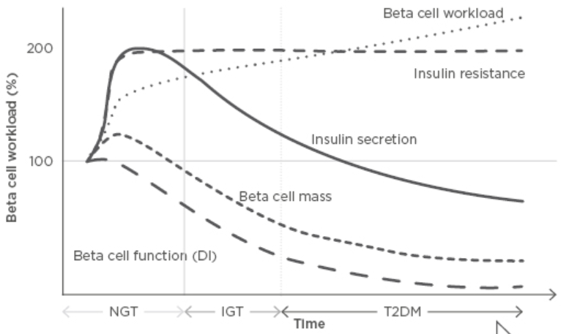



Introduction: T2DM
Importance:
2019: 463 million adults 2045: 700 million adults (1).
90-95% of all diabetes (2).
Pathophysiology:
51%
(3)
Notes:
Pathophysiology:
https://www.ncbi.nlm.nih.gov/pmc/articles/PMC4226760/
https://www.emjreviews.com/diabetes/article/editors-pick-how-can-we-develop-more-effective-strategies-for-type-2-diabetes-mellitus-prevention-a-paradigm-shift-from-a-glucose-centric-to-a-beta-cell-centric-concept-of-diabetes/
T2DM is generally believed to develop after the onset of insulin resistance due to the beta cell dysfunction that results from the increased need for insulin secretion. This beta cell dysfunction is especially relevant since no production of new beta cells occurs past the age of 30 in the human pancreas. Hence, insulin resistance is believed to be a critical step in the development of T2DM. For this reason, great efforts are being made in order to investigate factors that influence insulin sensitivity.

Slide 3
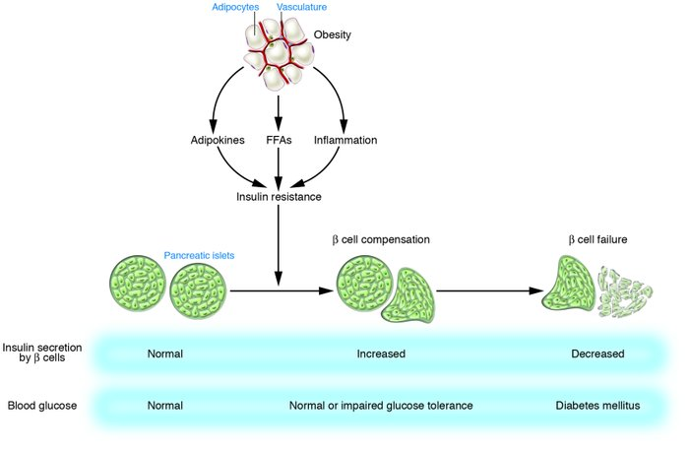
Introduction: T2DM
Importance:
2019: 463 million adults 2045: 700 million adults (1).
90-95% of all diabetes (2).
Pathophysiology:
51%
(3)
https://www.jci.org/articles/view/29189/figure/1
Notes:
Pathophysiology:
https://www.ncbi.nlm.nih.gov/pmc/articles/PMC4226760/
https://www.emjreviews.com/diabetes/article/editors-pick-how-can-we-develop-more-effective-strategies-for-type-2-diabetes-mellitus-prevention-a-paradigm-shift-from-a-glucose-centric-to-a-beta-cell-centric-concept-of-diabetes/
T2DM is generally believed to develop after the onset of insulin resistance due to the beta cell dysfunction that results from the increased need for insulin secretion. This beta cell dysfunction is especially relevant since no production of new beta cells occurs past the age of 30 in the human pancreas. Hence, insulin resistance is believed to be a critical step in the development of T2DM. For this reason, great efforts are being made in order to investigate factors that influence insulin sensitivity.

Slide 4


Introduction: IR at the omics level
Host Metabolome
Microbial Metagenome
Host Proteome
↓ Bacteroidetes/Firmicutes
ratio in T2D. (4)
Genetic
predisposition (6)
Hypertriglyceridemia (5)
Unrestrained
gluconeogenesis (5)
IR
IR
IR
$↑$ BCAA
Specific taxa = associated
with improved insulin
sensitivity or with insulin resistance (9)
Differential expression
of genes involved in
BCAA catabolism (7)
Notes:
Nevertheless, this interaction is still poorly understood and the changes in the omics of type 2 diabetic individuals remain debatable, especially in the time-period prior to diabetes onset.

Slide 5

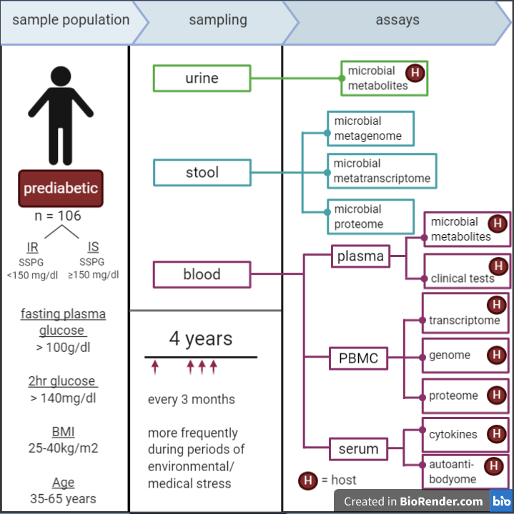
Aim
Investigate the changes in microbiome, host metabolome and host proteome between insulin resistant and insulin sensitive prediabetics.
Sample population and general sampling protocol of the iHMP’s T2DM project. PBMC = peripheral blood monocytes. Figure adapted from an iHMP Research Network Consortium publication (4).

Slide 6








Methods
Proteome data
Metabolome data
Metagenome data
iHMP T2DM data
Pre-processing
Isolated analysis of each omic
Combined analysis
Pathway analysis
(PathVisio & MetaboAnalyst)
Network Analysis
(Cytoscape)
60 subjects:
28 = IS
32 = IR
Subject data
Classification and data availability
Differential Analysis
(limma package)
Average per subject
Differential Analysis
(MetaboDiff package)
Average per subject
only HMDB included
Combined analysis
Filtering taxa (NA ranks & prevalence)
PCA
PERMANOVA
Homogeneity check
Top taxa
Phyla abundances
PCoA
Incl. samples in both
Excl. of outliers
Sparse CCA

Slide 7

PART Ia
Metagenome data
402 samples
362 taxa

Slide 8
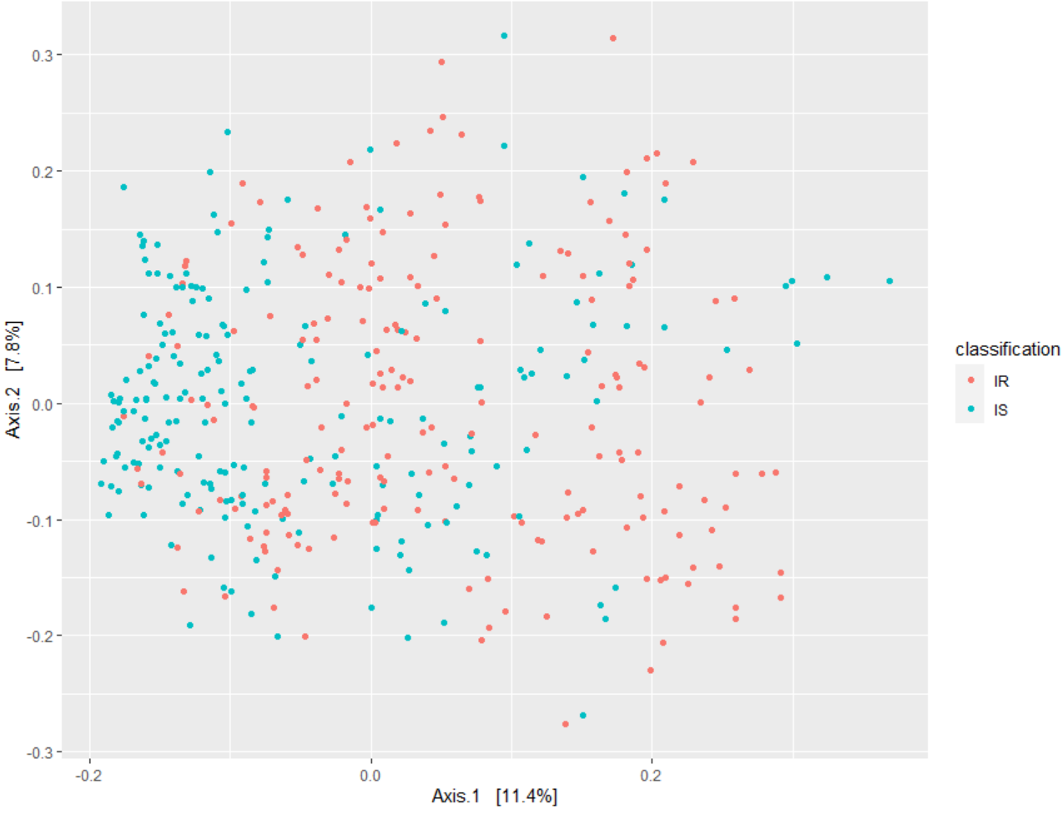
Results: PCoA with Bray Curtis dissimilarity Is there metagenomic separation between IR and IS?
17
All points = samples
Notes:
Check if groups are homogenous based on p-value!

Slide 9
Results: PERMANOVA Is this separation significant?
17
YES!
p = 0.010
Conclusion
The IR group likely has a distinct microbiome from the IS group.
BUT there also seems to exist differences within each group.
Notes:
adonis works by first finding the centroids for each group and then calculates the squared deviations of each of sample to that centroid. Then significance tests are performed using F-tests based on sequential sums of squares from permutations of the raw data. (https://chrischizinski.github.io/rstats/adonis/)
This could be due to subject characteristics that were not taken into account during the study, such as ethnicity.

Slide 10
Results: Homogeneity check What could explain this separation?
17
Could this separation be explained by different variances of the groups?
Method: Analysis of multivariate homogeneity of group variances (betadisper)
Result: p = 1.171
Conclusion
The metagenomic separation is unlikely to be the result of unequal variances between the 2 groups.
Notes:
adonis works by first finding the centroids for each group and then calculates the squared deviations of each of sample to that centroid. Then significance tests are performed using F-tests based on sequential sums of squares from permutations of the raw data. (https://chrischizinski.github.io/rstats/adonis/)
This could be due to subject characteristics that were not taken into account during the study, such as ethnicity.

Slide 11
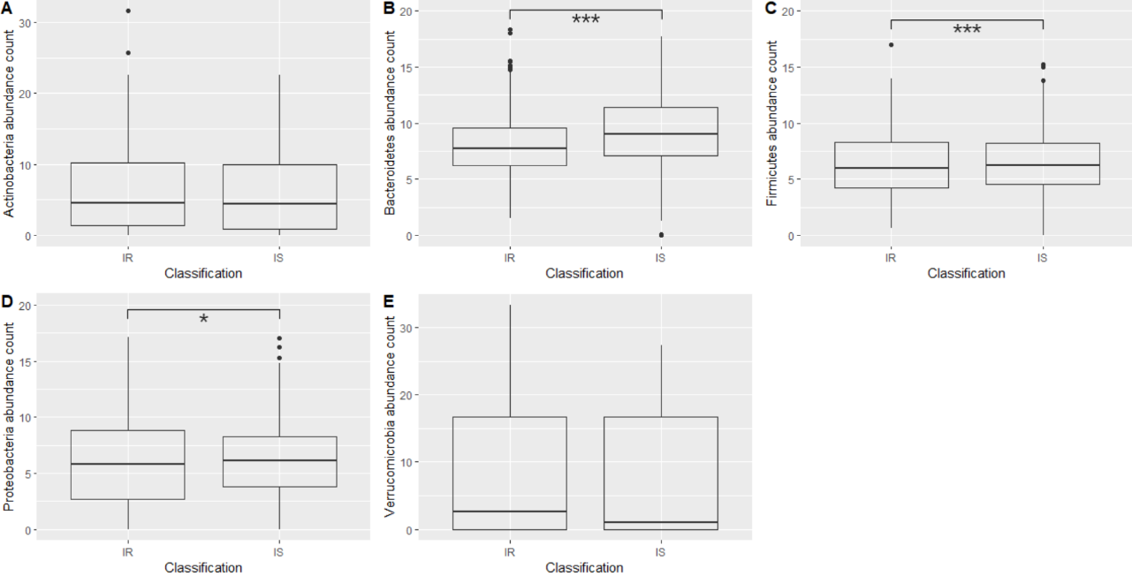
Results: Phyla abundances What could explain this separation?
11

Slide 12
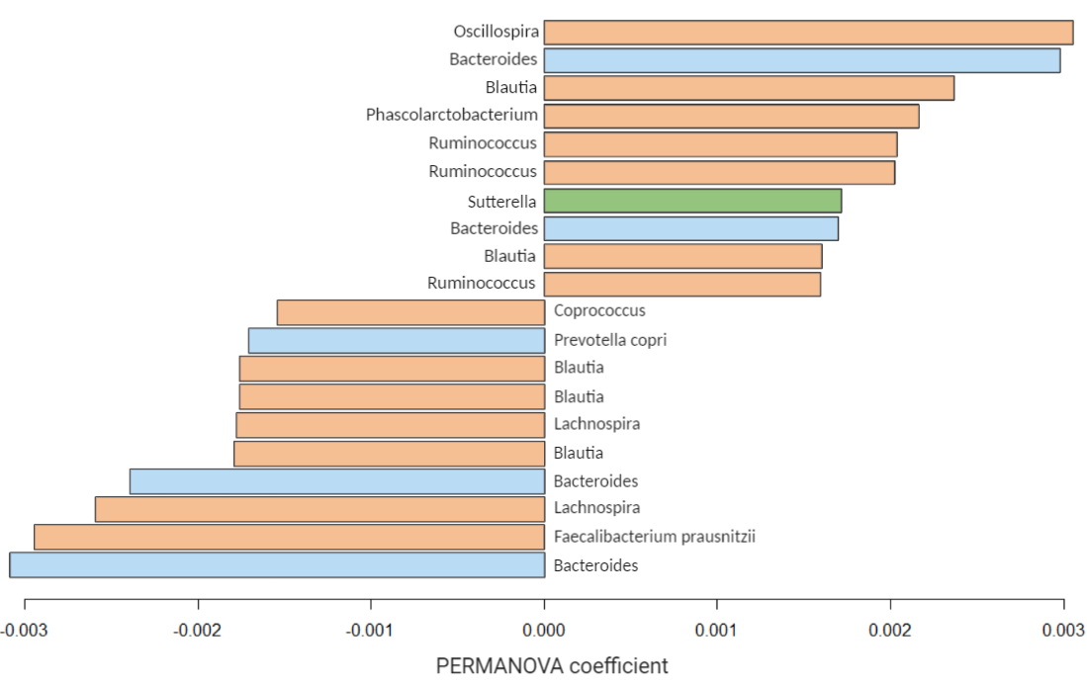
Results: Contributing microbes What could explain this separation?
11
Firmicutes
Bacteroidetes
Proteobacteria
More abundant in IR
Genus of microbes contributing the most to the metagenomic separation:
Oscillospira (phylum Firmicutes): more abundant in IR.
Bacteroides (phylum Bacteroidetes): less abundant in IR.
More abundant in IS
Bar plot of the OTUs generated by the PERMANOVA deemed to contribute the most to the separation between the IS and IR groups.
For each OTU, the corresponding genus and species (if available) is given.
Notes:
PERMANOVA coefficient = the squared deviations of each of sample to the centroid of each group.

Slide 13
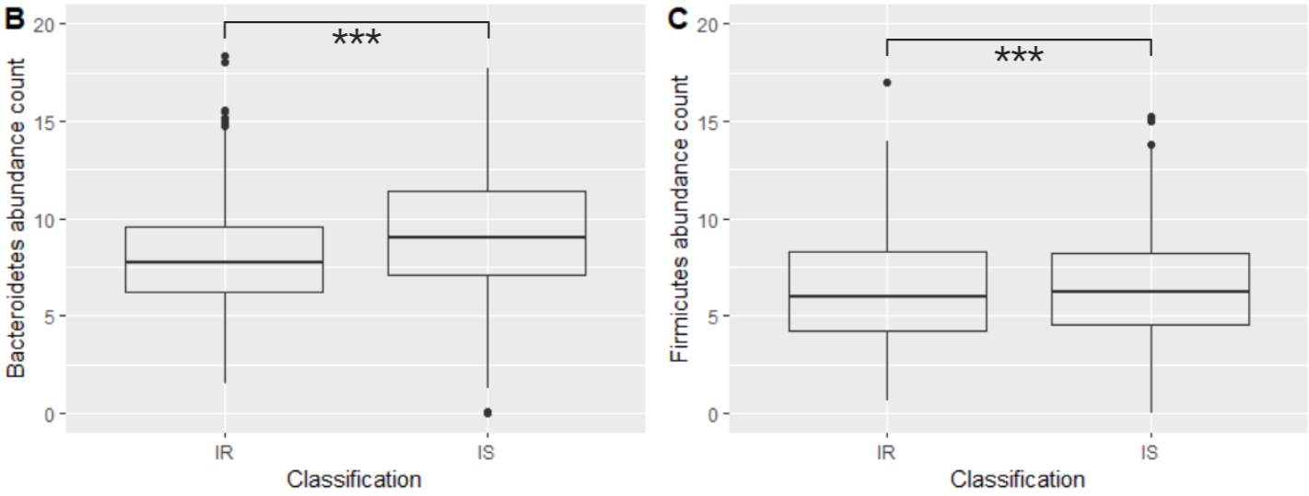

Discussion: Bacteroidetes/Firmicutes
11
↓ Bacteroidetes/Firmicutes
ratio in T2D. (4)
BUT very small change
Why?
↓ Bacteroidetes/Firmicutes ratio in obesity. (reference)
iHMP data: BMI = 25-40kg/m2
Conclusion
Small change could be due to the IS subjects also being obese.

Slide 14
Discussion: Bacteroidetes/Firmicutes
11
Firmicutes
More abundant in IR
↓ Bacteroidetes/Firmicutes
ratio in T2D. (4)
More abundant in IS
Bacteroidetes
Conclusion
Given the sample population, may be better to investigate the metagenomic differences at a level more specific than phylum.

Slide 15
PART Ib
18
Metabolome data
Metagenome data
323 metabolites
402 samples
362 taxa

Slide 16

Results: sparse CCA
19
Features best explaining the covariation between the metabolomic and metagenomic data
13 microbes
All = Firmicutes.
6 = Faecalibacterium prausnitzii (↓ in IR)
3 = Oscillospira ($↑$ in IR).
2 = Coprococcus (↓ in IR).
11 metabolites
10 = monoacylglycerols with 1 of these being 2-arachidonoylglycerol (2-AG).
Remaining 1 = arachidonic acid.
Do these metabolites have a significantly different abundance between the 2 conditions?
Notes:
This method compares sets of features across high-dimensional data tables, where there may be more measured features than samples. In the process, it chooses a subset of available features that capture the most covariance – these are the features that reflect signals present across multiple tables.
https://www.bioconductor.org/help/course-materials/2017/BioC2017/Day1/Workshops/Microbiome/MicrobiomeWorkflowII.html#graph-based_analyses

Slide 17

PART II
Proteome data
Metabolome data
686 samples
302 proteins
726 samples
323 metabolites

Slide 18

Results: 2 & 3 Differential Analysis
Proteomic
Metabolomic
Limma package
MetaboDIff package
P-value < 0.05: 23 proteins
Upregulated (logFC > 0): 13 proteins.
Downregulated (logFC < 0): 10 proteins
P-value < 0.05: 40 metabolites
Upregulated (logFC > 0): 19 metabolites.
Downregulated (logFC < 0): 21 metabolites.

Slide 19
Results: 2 & 3 Differential Analysis
Proteomic
Metabolomic
Limma package
MetaboDIff package
P-value < 0.05: 23 proteins
P-value < 0.05: 40 metabolites
APOC4
APOD
APOA1
APOF
CFH
VTN
IL1RAP
C1QB
C4A HP
LPA
2-AG
Acetylcholine
L-glutamate
Pyroglutamic acid
VTN
IL1RAP
C1QB
Immune function
processes involved in Energy metabolism

Slide 20

Results: 5 Combined Pathway Analysis
PathVisio
Expression criterion: p < 0.05
MetaboAnalyst
Selection criteria: p < 0.05
15 metabolites
25 gene products
39 metabolites
23 proteins
18 significantly altered pathways (Z-score > 1.96)
Only 1 – 2 hits.
None with both proteins & metabolites.
3 with Z-score < 1.96 but more hits (3-5 hits)
All hits = proteins.
6 significantly altered pathways (p < 0.05)
4 pathways had 2 hits and 2 pathways had 1 hit.
All hits = metabolites.
Notes:
CHECK 15 METABOLITES? WHY NOT 40?

Slide 21
Results: 5 Combined Pathway Analysis
PathVisio
Expression criterion: p < 0.05
MetaboAnalyst
Selection criteria: p < 0.05
15 metabolites
25 gene products
39 metabolites
23 proteins
18 significantly altered pathways (Z-score > 1.96)
Only 1 – 2 hits.
None with both proteins & metabolites.
3 with Z-score < 1.96 but more hits (3-5 hits)
All hits = proteins.
6 significantly altered pathways (p < 0.05)
4 pathways had 2 hits and 2 pathways had 1 hit.
All hits = metabolites.
Notes:
CHECK 15 METABOLITES? WHY NOT 40?

Slide 22

Results: 5 Combined Pathway Analysis
PathVisio
Expression criterion: p < 0.05
MetaboAnalyst
KEGG (2019)
Pathway | Hits | logFC
IL-1 signalling | IL1RAP | -0.302
Signal transduction through IL1R | IL1RAP | -0.302
Sphingolipid pathway | Dihydro-sphingosine | -0.155
PPAR alpha pathway | APOA1 PLTP | -0.301 -0.458
Glutathione metabolism | L-Glutamate 5-Oxoproline | 0.288 0.157
Pathway | Hits | logFC
Sphingolipid metabolism | Sphinganine Sphingomyelin | -0.153 -0.332
Glutathione metabolism | L-Glutamate 5-Oxoproline | 0.288 0.157
D-Glutamine and D-glutamate metabolism | L-Glutamate | 0.288
Nitrogen metabolism | L-Glutamate | 0.288
Notes:
CHECK 15 METABOLITES? WHY NOT 40?

Slide 23

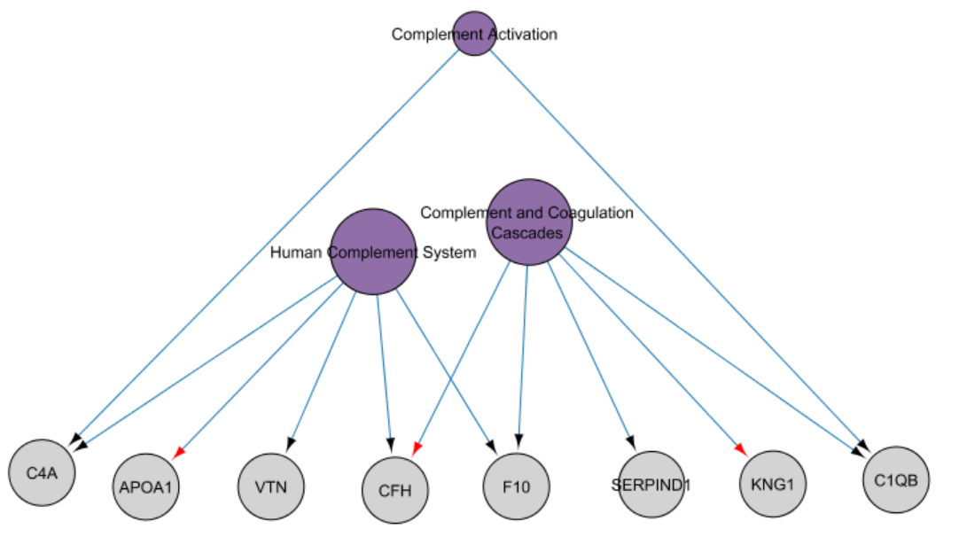
Results: 6 Network Analysis
Pathways = purple, proteins (HGNC annotation) = grey.
Size of the pathway nodes represents their out-degree size.

Slide 24

Discussion: sparse CCA
19
Host metabolome-microbiome interaction
13 microbes
All = Firmicutes.
6 = Faecalibacterium prausnitzii (↓ in IR)
3 = Oscillospira ($↑$ in IR).
2 = Coprococcus (↓ in IR).
11 metabolites
10 = monoacylglycerols with 1 of these being 2-arachidonoylglycerol (2-AG).
Remaining 1 = arachidonic acid.
Conclusion
The lower abundance of F.prausnitzii in IR may explain the lower 2-AG levels since it may be an indication of low A. muciniphila.
Cross-fed by Akkermansia muciniphila
Notes:
This method compares sets of features across high-dimensional data tables, where there may be more measured features than samples. In the process, it chooses a subset of available features that capture the most covariance – these are the features that reflect signals present across multiple tables.
https://www.bioconductor.org/help/course-materials/2017/BioC2017/Day1/Workshops/Microbiome/MicrobiomeWorkflowII.html#graph-based_analyses

Slide 25
PART IIa
Metagenome data
402 samples
981 taxa

Slide 26
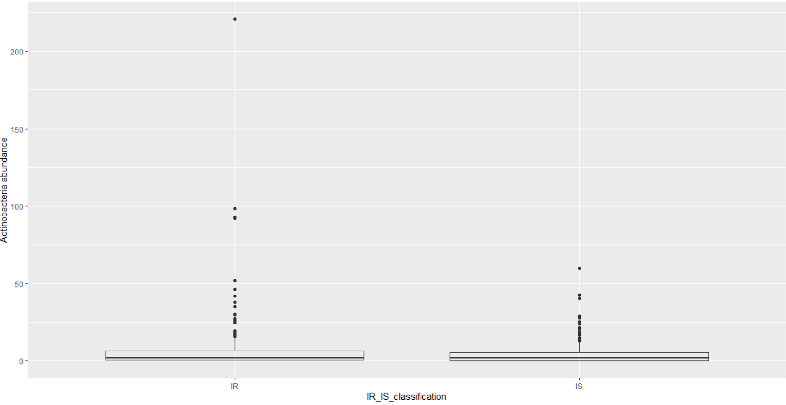
Results: 4 Actinobacteria abundance
11
p = 0.079

Slide 27
Results: 4 Actinobacteria abundance
11
p = 0.079

Slide 28
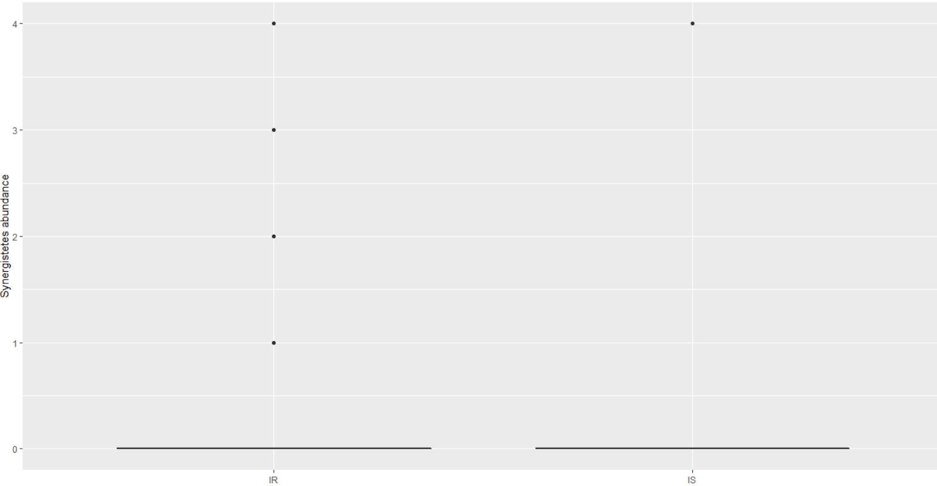
Results: 4 Synergistetes abundance
12
p = 3.754e-06

Slide 29
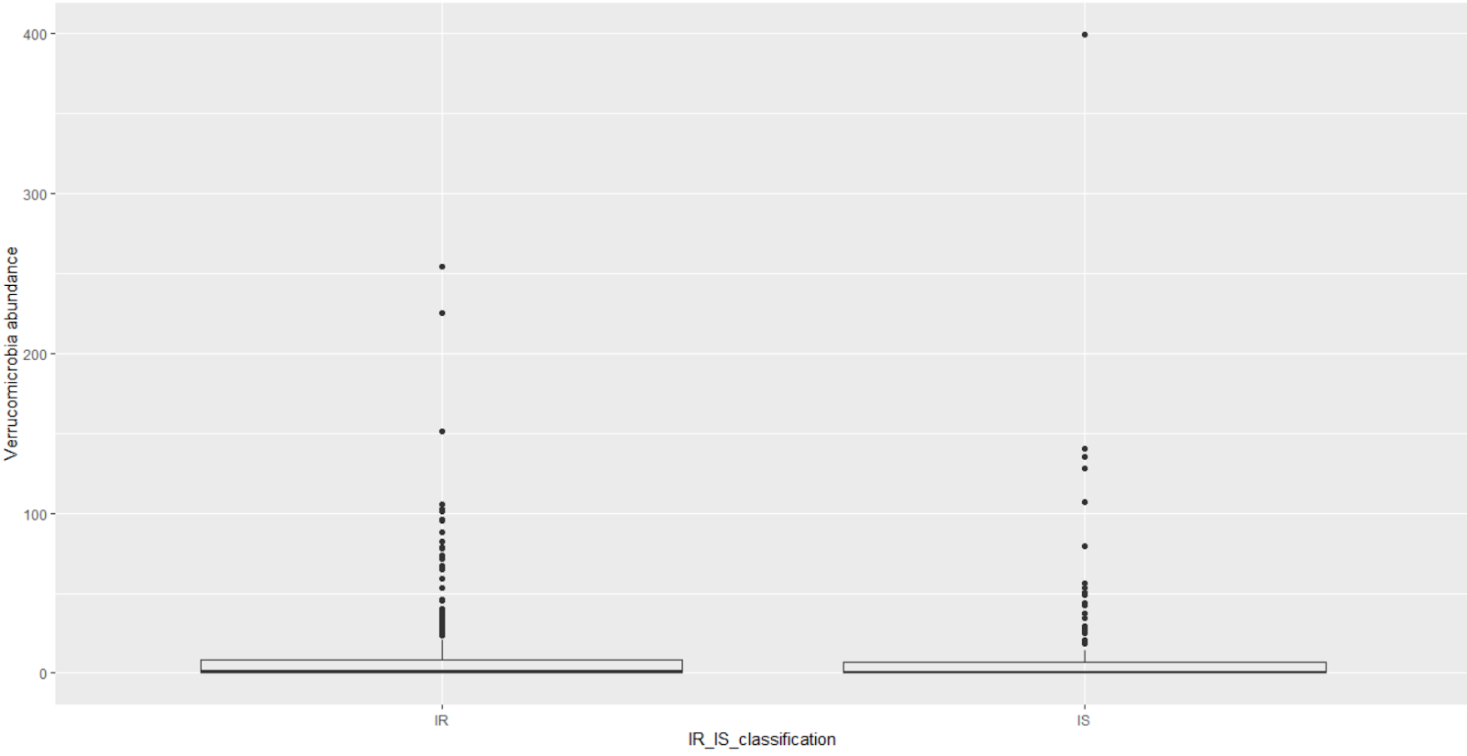
Results: 4 Verrucomicrobia abundance
13
p = 0. 003

Slide 30
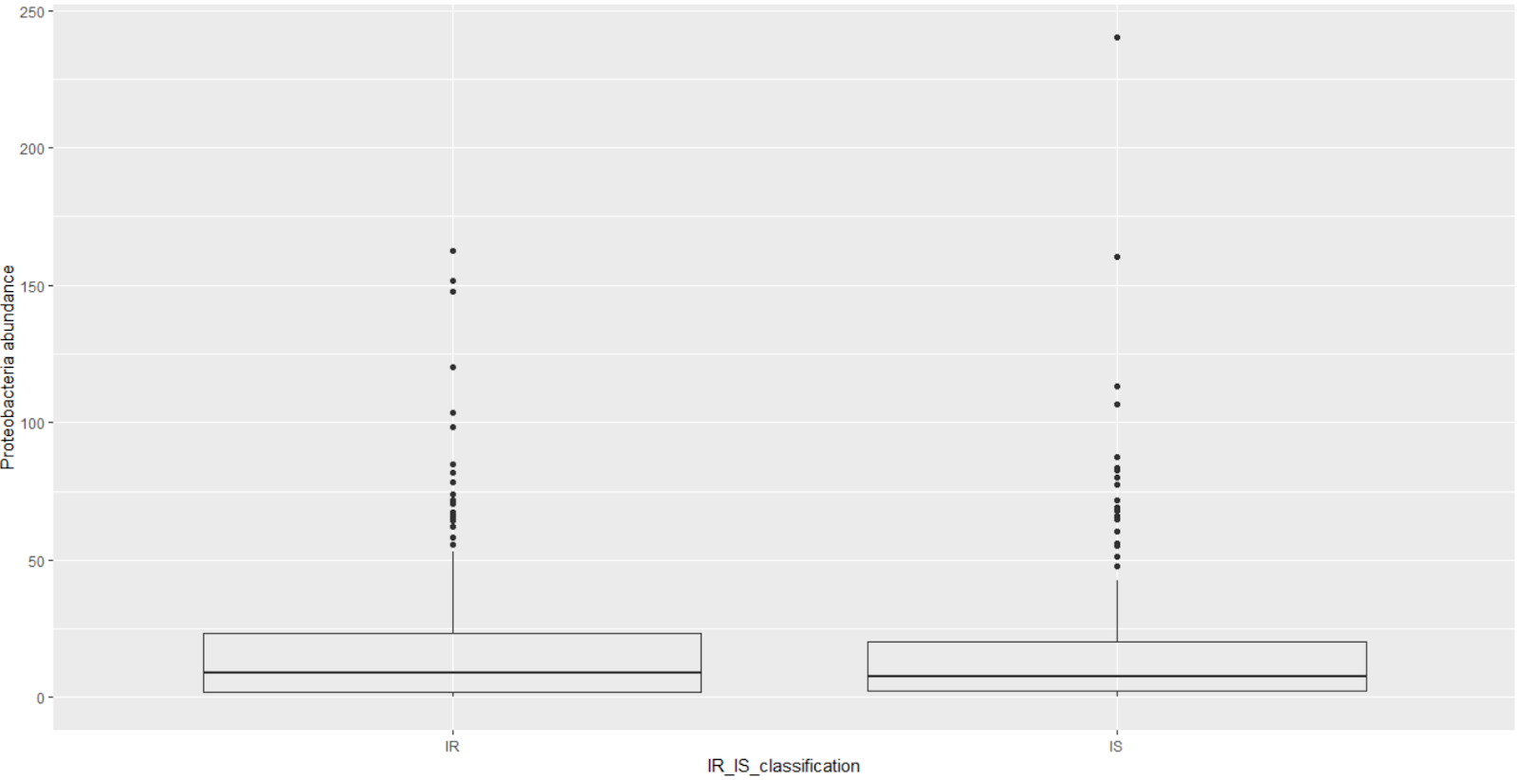
Results: 4 Proteobacteria abundance
14
p = 0.012

Slide 31
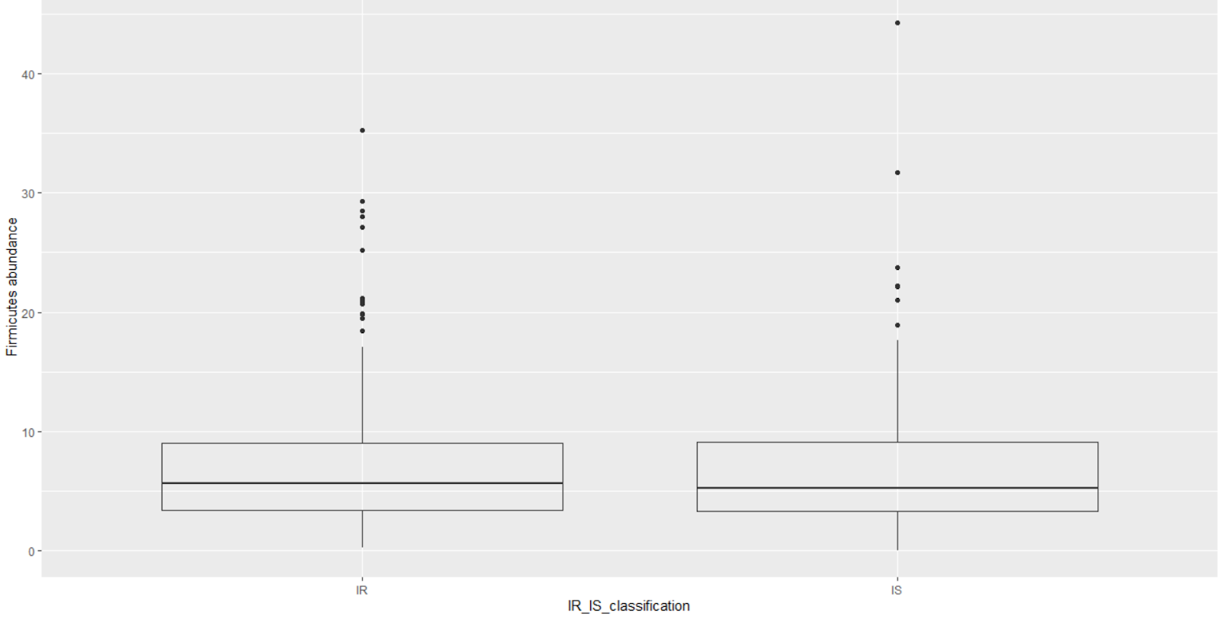
Results: 4 Firmicutes abundance
15
p = 5.451e-11

Slide 32
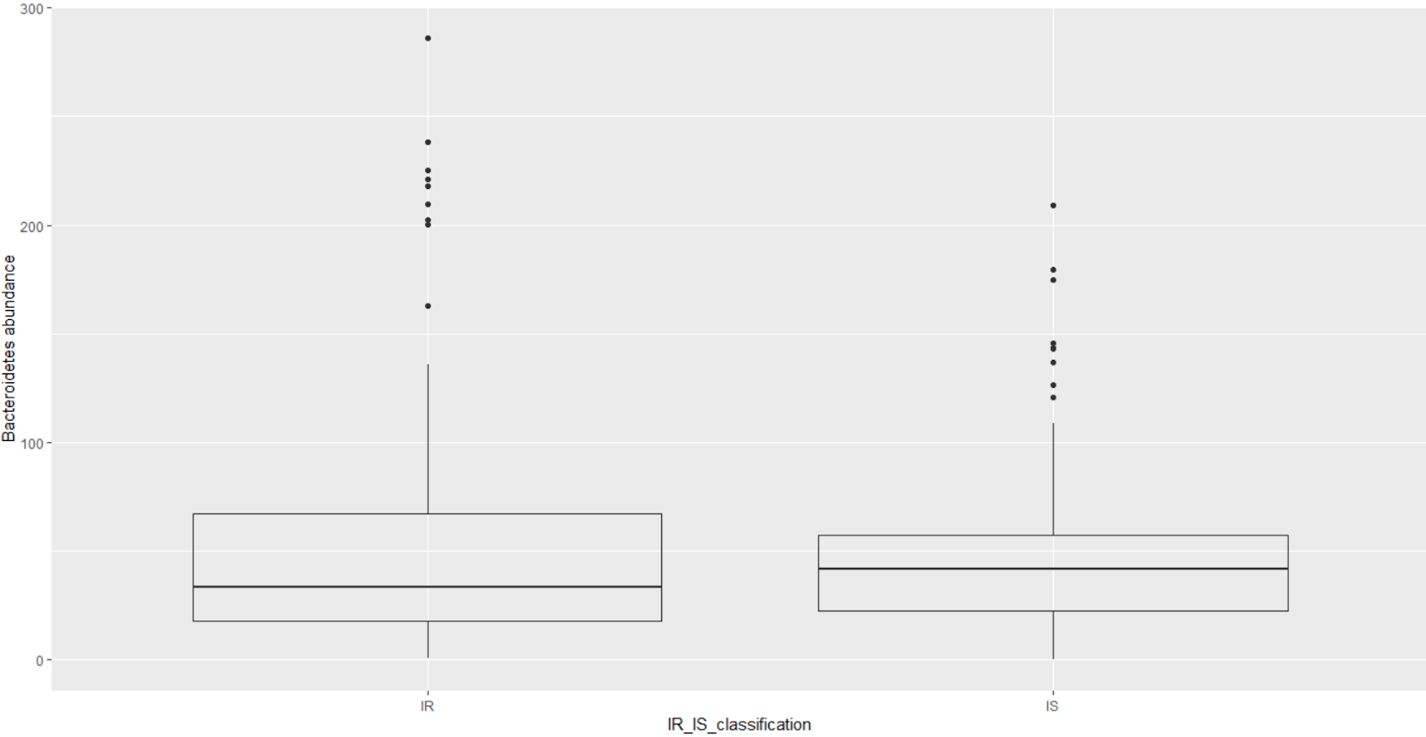
Results: 4 Bacteroidetes abundance
16
p = 0.001

Slide 33
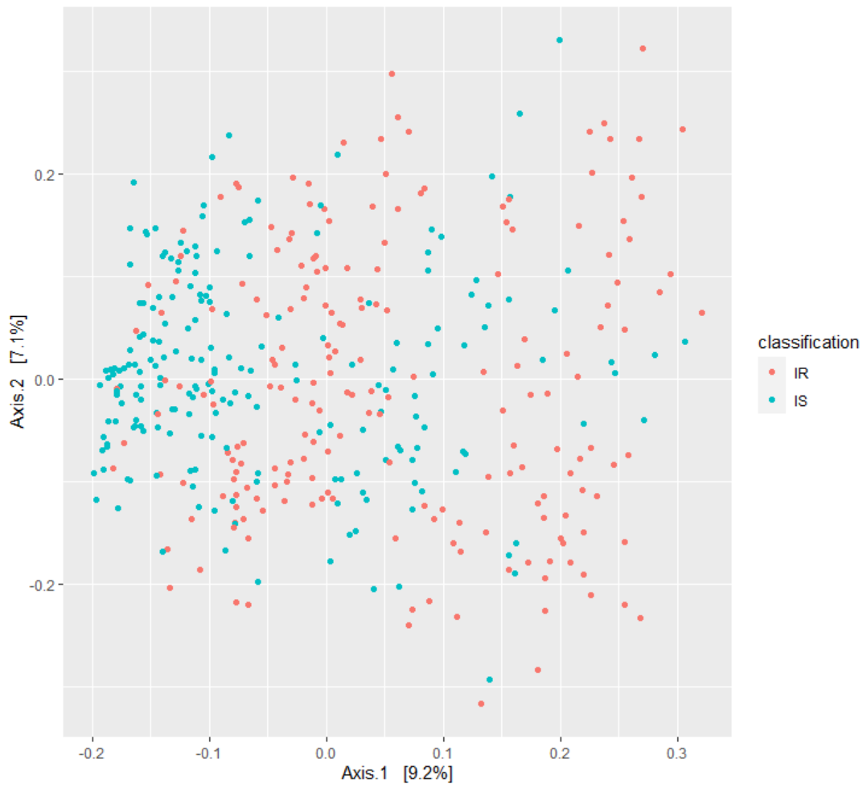
Results: 4 PCoA
17
All points = samples
Notes:
Check if groups are homogenous based on p-value!

Slide 34
PART IIb
18
Metabolome data
Metagenome data
323 metabolites
402 samples
888 taxa

Slide 35
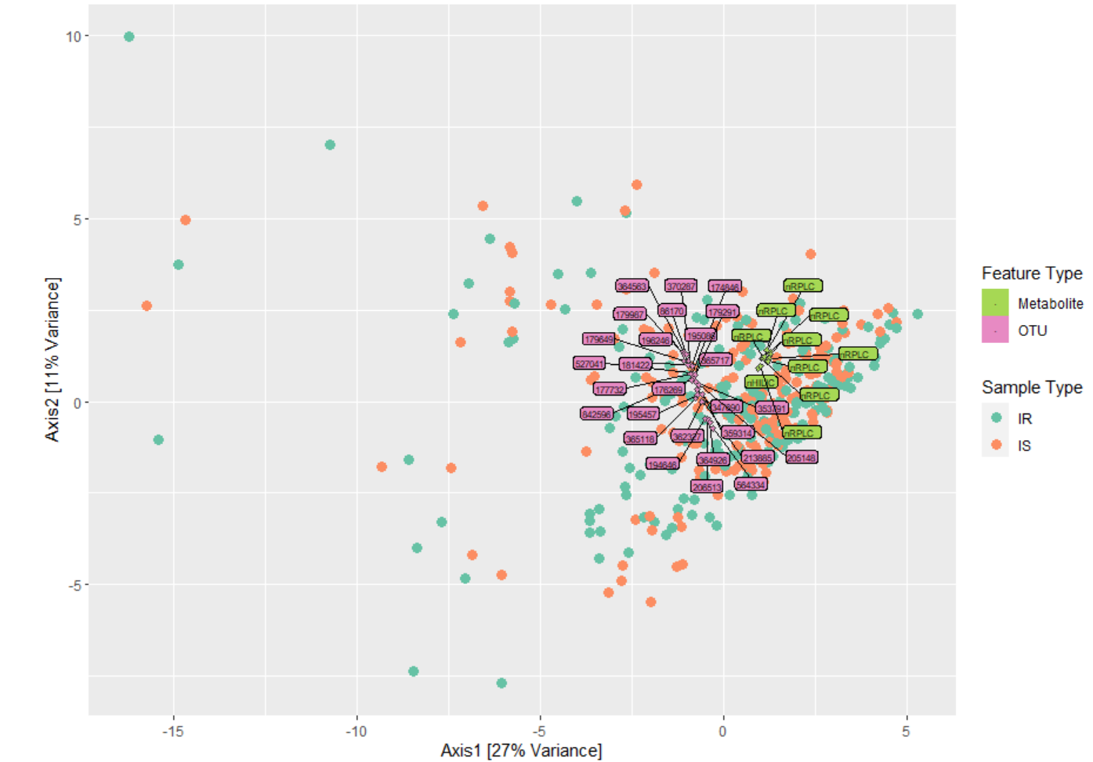
Results: 7 CCA, PCA & PERMANOVA
19
Sparse CCA
27 microbes
10 metabolites
Correlation coefficient = 0.482
Best explanatory features of covariation in the data of each classification
PERMANOVA
p = 0.01 R2 = 0.021
Homogeneity check
p = 0.542

Slide 36
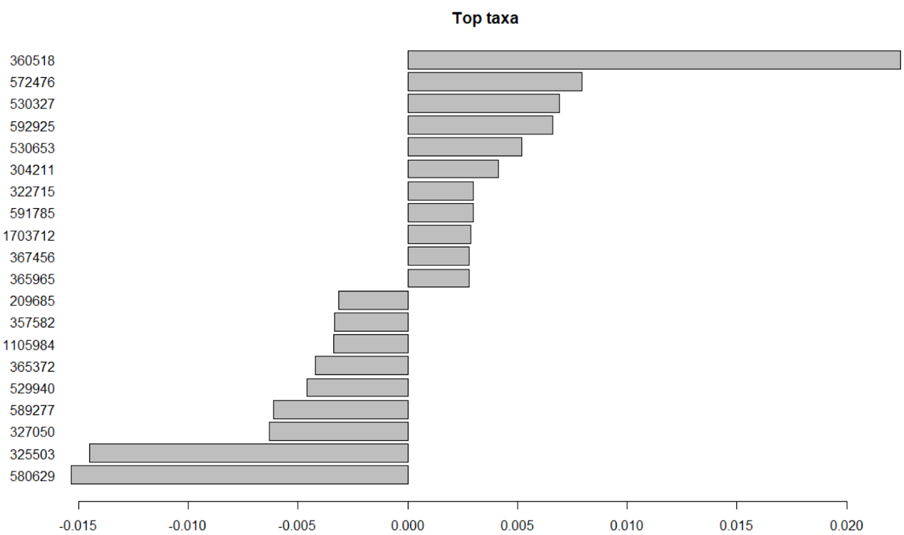
Results: 7 Identification of top taxa
20
Bacteroides
Bacteroides uniformis
Faecalibacterium prausnitzii
Prevotella copri
Prevotella copri
More abundant in IR
Ruminococcus
Bacteroides eggerthii
Prevotella stercorea
Bacteroides
Blautia
Ruminococcus
Bacteroides
Bacteroides
Bacteroides
Faecalibacterium prausnitzii
Less abundant in IR
Faecalibacterium prausnitzii
Bacteroides
Bacteroides
Bacteroides
Bacteroides

Slide 37
Results: 8 Taxon set enrichment analysis
21
Associated host genes
Associated intrinsic host factors
p < 0.05
p < 0.05
More abundant in IR | Less abundant in IR
RFT1 | SRA1
LINGO2 | JPH3
SLCA2 | ADAMTS4
ADCK4 | CDH20
CACNA1E
PNPLA7
SLC45A1
TFR2
UTP14C
More abundant in IR | Less abundant in IR
(Liver) cirrhosis | Colorectal carcinogenesis
Fibromyalgia
Colorectal carcinogenesis
Type 1 diabetes
Alzheimer’s disease

Slide 38
Next steps…
22
1. Finalisation of part II.
2. More in depth understanding of the analyses performed in part II.
3. Interpretation of the results.

Slide 39
References
International Diabetes Federation. IDF Diabetes Atlas, 9th edn. Brussels, Belgium: 2019. Available at: https://www.diabetesatlas.org
American Diabetes Association. 2. Classification and diagnosis of diabetes: standards of medical care in diabetes—2019. Diabetes Care. 2019 Jan 1;42(Supplement 1):S13-28
Saisho Y. How Can We Develop More Effective Strategies for Type 2 Diabetes Mellitus Prevention? A Paradigm Shift from a Glucose-Centric to a Beta Cell-Centric Concept of Diabetes. DIABETES. 2018 Nov.
Integrative HM. The Integrative Human Microbiome Project: dynamic analysis of microbiome-host omics profiles during periods of human health and disease. Cell host & microbe. 2014 Sep 10;16(3):276.

Slide 40
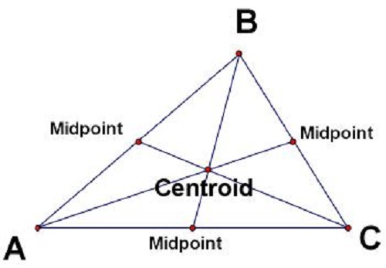
the centre of mass of a geometric object of uniform density.
http://www.differencebetween.net/science/difference-between-centre-of-gravity-and-centroid/

Slide 41
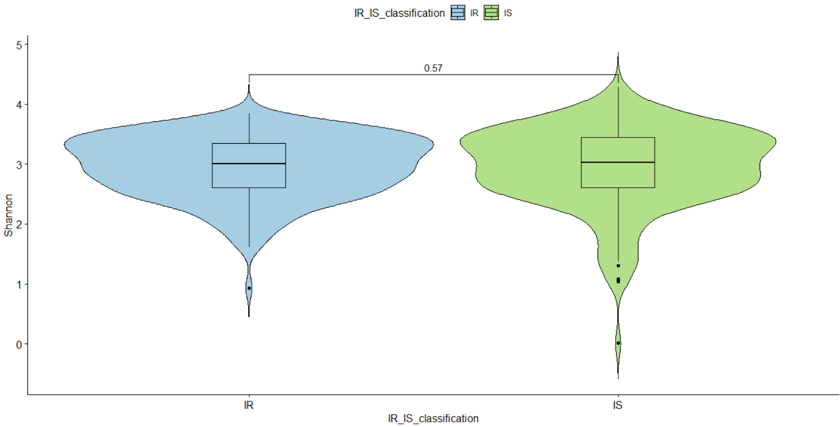
Results: 4 Shannon diversity
17
= measure of species diversity and evenness
Notes:
Species evenness refers to how close in numbers each species in an environment is.
Species abundance is the number of taxa per species

Slide 42
References
International Diabetes Federation. IDF Diabetes Atlas, 9th edn. Brussels, Belgium: 2019. Available at: https://www.diabetesatlas.org
American Diabetes Association. 2. Classification and diagnosis of diabetes: standards of medical care in diabetes—2019. Diabetes Care. 2019 Jan 1;42(Supplement 1):S13-28
Saisho Y. How Can We Develop More Effective Strategies for Type 2 Diabetes Mellitus Prevention? A Paradigm Shift from a Glucose-Centric to a Beta Cell-Centric Concept of Diabetes. DIABETES. 2018 Nov.
Integrative HM. The Integrative Human Microbiome Project: dynamic analysis of microbiome-host omics profiles during periods of human health and disease. Cell host & microbe. 2014 Sep 10;16(3):276.
Ferrannini E, Gastaldelli A, Iozzo P. Pathophysiology of prediabetes. Medical Clinics. 2011 Mar 1;95(2):327-39.
Guillet C, Masgrau A, Walrand S, Boirie Y. Impaired protein metabolism: interlinks between obesity, insulin resistance and inflammation. Obesity Reviews. 2012 Dec;13:51-7.
Sears DD, Hsiao G, Hsiao A, Yu JG, Courtney CH, Ofrecio JM, Chapman J, Subramaniam S. Mechanisms of human insulin resistance and thiazolidinedione-mediated insulin sensitization. Proceedings of the National Academy of Sciences. 2009 Nov 3;106(44):18745-50.
Patti ME, Butte AJ, Crunkhorn S, Cusi K, Berria R, Kashyap S, Miyazaki Y, Kohane I, Costello M, Saccone R, Landaker EJ. Coordinated reduction of genes of oxidative metabolism in humans with insulin resistance and diabetes: Potential role of PGC1 and NRF1. Proceedings of the National Academy of Sciences. 2003 Jul 8;100(14):8466-71.
Gurung M, Li Z, You H, Rodrigues R, Jump DB, Morgun A, Shulzhenko N. Role of gut microbiota in type 2 diabetes pathophysiology. EBioMedicine. 2020 Jan 1;51:102590.

